Slide 1
Pre-dosing with lilotomab prior to therapy with 177Lu-lilotomab satetraxetan significantly increases the ratio of tumour to red marrow absorbed dose in non-Hodgkin lymphoma patients
J. Blakkisrud¹, A. Løndalen², J. Dahle³, ACT. Martinsen^{1, 4}, H. Holte⁵, A. Kolstad⁵, and C. Stokke^{1, 6}
¹Department of Diagnostic Physics, Oslo University Hospital, Oslo, NORWAY
²Division of Radiology and Nuclear Medicine, Oslo University Hospital, Oslo, NORWAY
³Nordic Nanovector ASA, Oslo, NORWAY
⁴The Department of Physics, University of Oslo, Oslo, Norway
⁵Department of Oncology, Radiumhospitalet, Oslo University Hospital, Oslo, NORWAY
⁶Oslo and Akershus University College of Applied Science, Oslo, NORWAY

Slide 2
EANM Disclosure Statement
1) I or one of my co-authors hold a position as an employee, consultant, assessor or advisor for a pharmaceutical, device or biotechnology company. If yes, please specify name/position/company:
A Kolstad is a member of the Scientific Advisory Board of Nordic Nanovector. J Dahle is the Chief Scientific Officer of Nordic Nanovector ASA
2) I or one of my co-authors receive support from a pharmaceutical, device or biotechnology company. If yes, please specify name/position/company/which project and whether support is in kind or monetary:
A Løndalen is involved in Nordic Nanovector funded participation of Oslo University Hospital Dept. of Radiology and Nuclear Medicine in Lymrit 37-01 study
3) I or one of my co-authors hold property rights/patents for (radio)pharmaceuticals, medical devices or medical consulting firms. If yes, please specify name/position/company:
Nothing to disclose
4) I or one of my co-authors have written articles for (radio)pharmaceutical, medical device, biotechnology or consulting companies during the last 5 years. If yes, please specify name/position/company/article/ journal and co-authors:
J Dahle has written articles for Nordic Nanovector ASA, they are avaliable at the following adress: http://www.nordicnanovector.com/product-info/scientific-papers

Slide 3
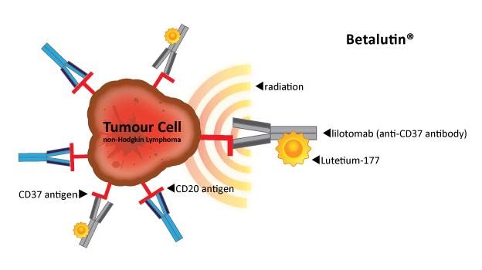
177Lu-lilotomab satetraxetan (Betalutin®)
¹⁷⁷Lu-lilotomab satetraxetan (Betalutin®) is a novel antibody radionuclide conjugate targeting the CD37 antigen expressed on malignant B-cells.
¹⁷⁷Lu-lilotomab satetraxetan is currently investigated in the multi-center phase 1/2 LYMRIT 37-01 study headed by Oslo University Hospital. Patients with relapsed indolent non-Hodgkin lymphoma are included.

Slide 4
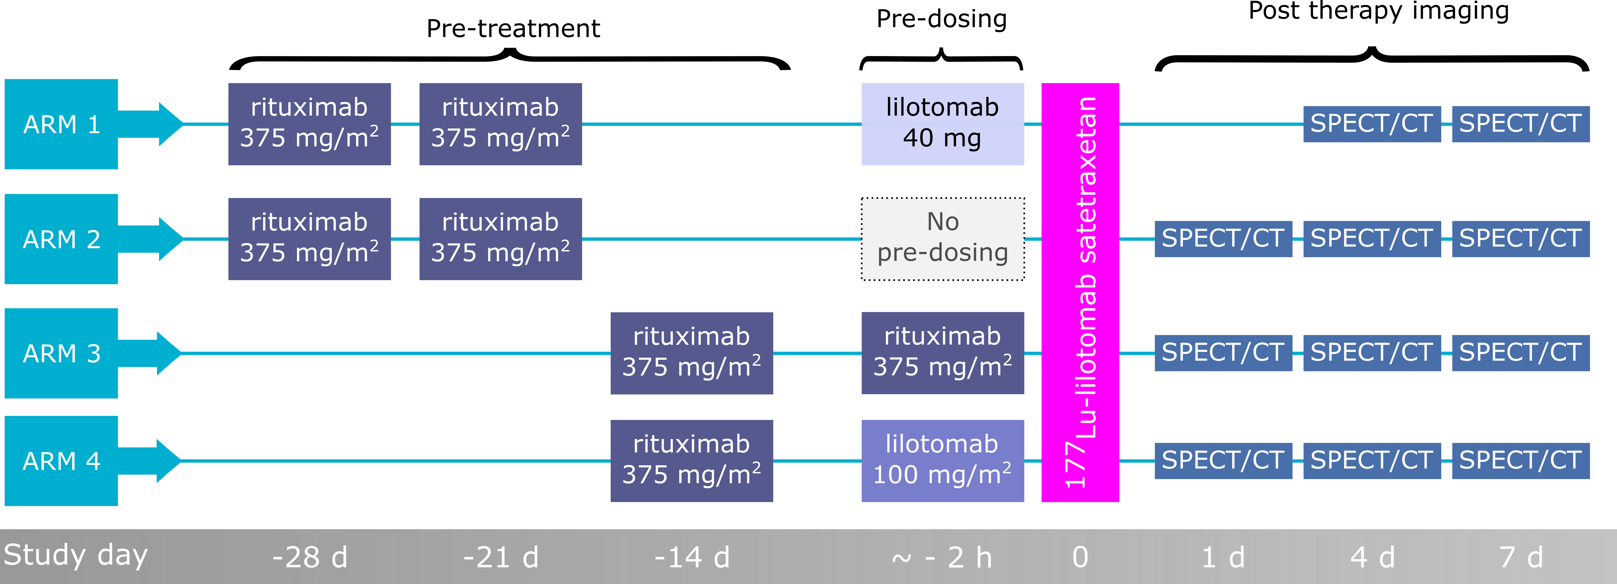
Treatment arms

Slide 5
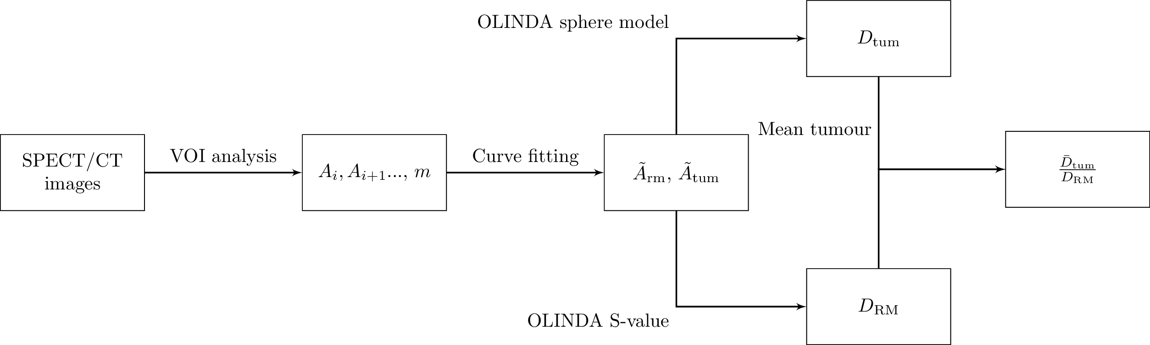

Slide 6
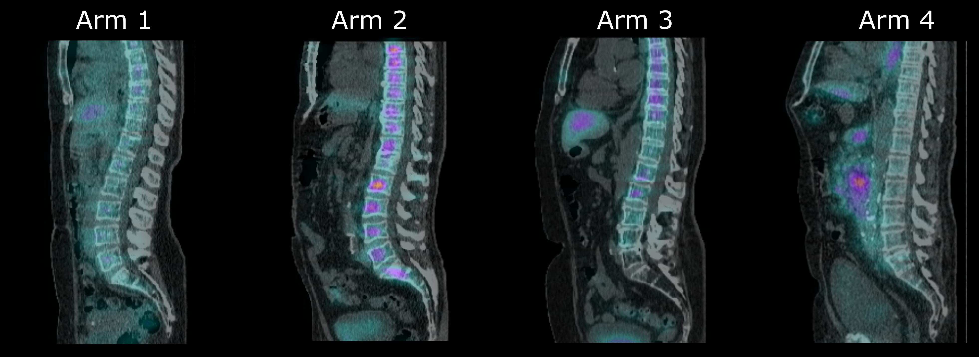
SPECT/CT images
The sagittal fused SPECT/CT images above were acquired four days after 177Lu-lilotomab satetraxetan administration and show patients that received the same amount of activity per kilogram body mass
A reduction in red marrow uptake can be observed for patients in arm 1 and 4 compared to patients that did not receive pre-dosing with lilotomab (arm 2+3).

Slide 7
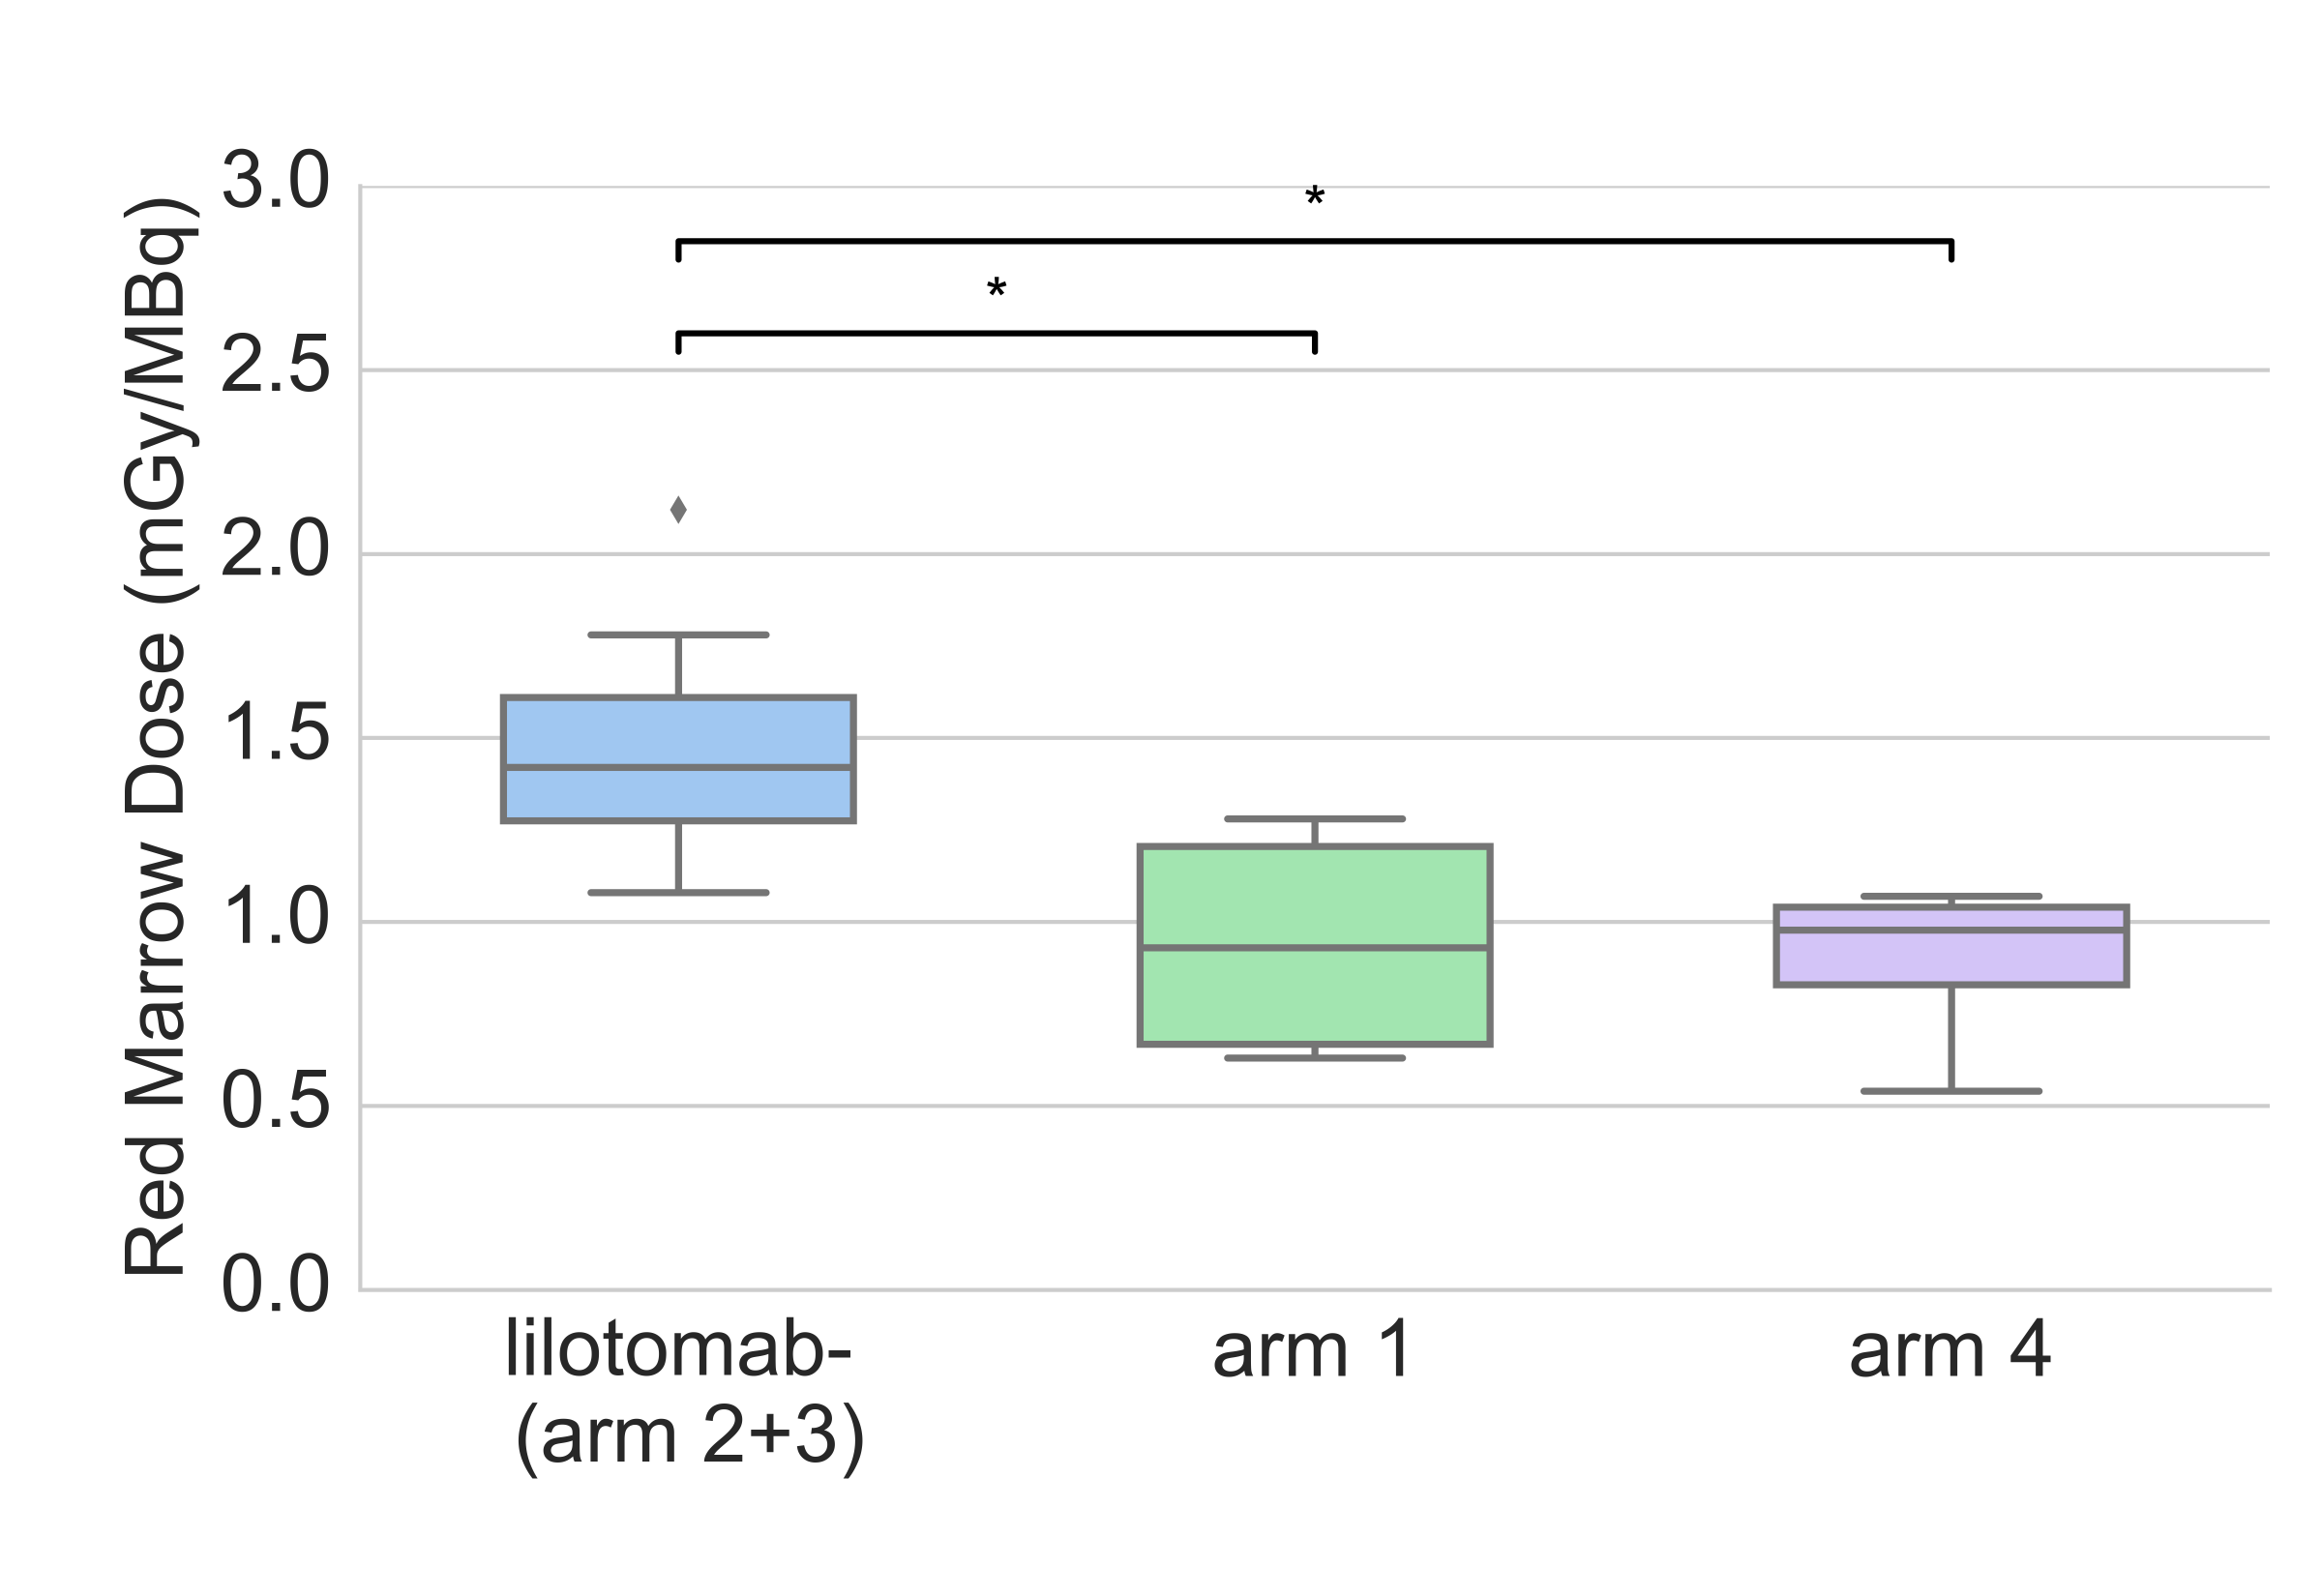
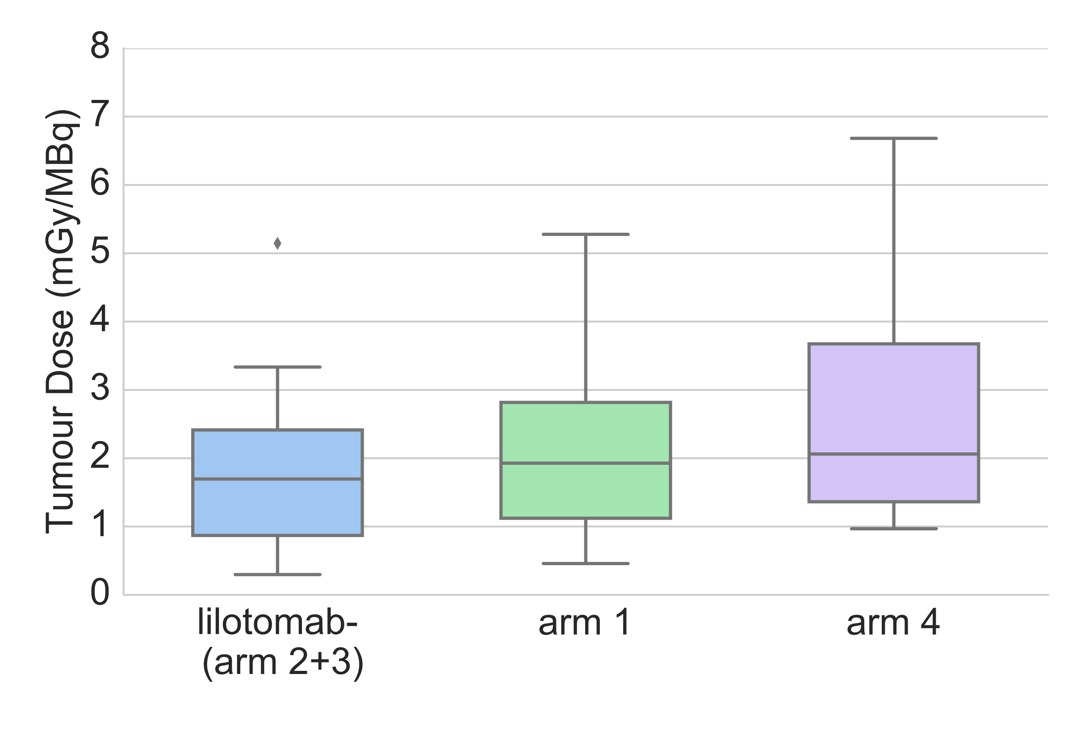
Red Marrow Absorbed Dose
Tumour Absorbed Dose

Slide 8
Dosimetry
The ratio of tumour to red marrow absorbed dose was significantly higher in both arm 1 and arm 4 compared to the group that did not receive unlabelled lilotomab.

Slide 9
In summary:
For all patient arms, red marrow was found to be the primary dose-limiting organ for ¹⁷⁷Lu-lilotomab satetraxetan therapy, and pre-dosing with lilotomab had a mitigating effect on red marrow absorbed dose.
Both pre-dosage levels investigated significantly increased the tumour to red marrow absorbed dose ratio after treatment with ¹⁷⁷Lu-lilotomab satetraxetan in patients with non-Hodgkin`s lymphoma. Pre-dosing should be considered mandatory in this treatment regimen.

Slide 10




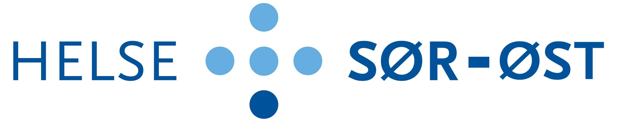
Thank you for your kind attention!

